Slide 1
Presentation for NAAC
Department of Political Science
Jesus and Mary College
University of Delhi

Slide 2
STRENGTHS OF THE DEPARTMENT
Highly Qualified Faculty - More than 70% of the Faculty members are Ph.D.
Highly Experienced Faculty - Majority of Faculty members have thirty to forty years of teaching experience. . They have also supervised Ph.D. thesis.
Promising Student Performance - Ex-students as well as current students of the department are working in various important fields.
Good Academic Record – Many of our students hold University positions
Informed, socially engaging pedagogy – Our students undertake field trip and visits to Panchayats and Parliament. They are also encouraged to carry out discussions and debates on important socio-political issues and challenges facing the country.
Usage of technical and innovative teaching and evaluation methods: Project reports, PowerPoint based presentations, online reading material, internet resources.
Active Faculty involvement in student related programs: In capacity of convenors of societies like Student Council, NSS, WSDC, ECA, Anti-ragging, Committee against sexual harrassment etc.
Dr. Sushila Ramaswamy, one of our faculty members, is a well known name in the discipline, has received various prestigious awards and has a number of quality publications to her credit.
One of our Faculty members has received intensive counselling training by Sanjeevani and has served on the College Counselling Cell.

Slide 3
About the Department
The Department of Political Science was established in 1968.
The Department offers undergraduate courses in Political Science. The objectives of the Department are:
To impart theoretical and empirical understanding of the subject to its students;
To help students pursue their higher education in Political Science;
To promote research endeavors of the faculty for better understanding of issues of political significance in India.

Slide 4
Courses taught in the Department
Number of Teaching Posts in the Department
 | Sanctioned | Filled
Associate Professors | 5 | 5
Assistant Professor | 1 | 1
Ad-hoc | 1 | 1
The Department offers following programs:
B.A.(Hons.)
BA(Prog.)
Interdisciplinary/Concurrent Courses to other Honors students

Slide 5
Main Papers taught by the Department are:
Colonialism in India
Understanding Political Theory
Constitutional Democracy and Government in India
International Relations Theory
Introduction to Comparative Government and Politics
Theories of Administration
Indian Political Thought
Development Process and social movements in Contemporary India
India’s Foreign Policy
Nationalism in India
Political Theory: Concepts and Debates
Political Processes in India
Global Politics
Political Institutions and Processes in Comparative Perspective
Public Policy and Administration in India
Classical and Modern Political Philosophy
Understanding South Asia
Feminism and Indian Politics

Slide 6
Interdisciplinary Courses taught and the Departments/units involved
Political Science Department Teaches
a) Citizenship in a Globalizing World to II Year Hindi (Hons.)
b) Contemporary India to II B.A. Programme
c) Gender and Society to II B.A. Programme
Sociology Department teaches the following to Political Science students:
a) Gender and Society to I Hons. Political Science
b) Contemporary India to II Hons. Political Science
Psychology Department teaches:
-Psychology for Living to III Hons. Political Science
English Department teaches:
Language, Literature and Cullture (Credit) to I Political Science Hons.
Applied Course Translation to I Political Science Hons.
Philosophy Department teaches:
-Ethics in Public Domain in lieu of non credit language to I Hons. Political Science

Slide 7
Strength of the department
Total no of students
BA (Hons.): Approximately 50 per class
BA (Program): Approximately 65 per class
Student-Teacher Ratio
BA (Hons.): 1:30
BA (Program):1:50
Diversity of students:
Name of Course | % of students from Delhi | % from other states | % from Abroad
BA (Hons) Pol Sc III | 89.5 | 10.5 | -
BA (Hons) Pol Sc II | 77.5 | 20.5 | 2
BA (Hons) Pol Sc I | 76 | 24
BA (Prog) Pol Sc III | 53 | 47

Slide 8
Faculty Profile (I)
Name | Qualification | Designation | Specialization | Experience | No. of Ph.D. students guided | Publications | Other Achievements
Dr. Monica Chopra | Ph.D. | Associate Professor | Indian Politics and Indian Political Thought | 42 years | 1 completed in 1992
Dr. Pamela Bhatia | Ph.D. | Associate Professor | Political Theory Indian Politics African Studies | 42 years | - |  | Convenor WSDC
Dr. Sushila Ramaswamy | M.Phil., Ph.D. | Associate Professor | Political Theory | 33 years | 1 (under progress 2014) | Books: Authored: 3 Co authored: 7 Co-Edited: 13 Articles: International: 2 National 23 | Student Council Co-Convenor 2014-16, ECA Convenor 2013-15, Staff Advisor to Pol. Sc. Association, Co- Convenor WSDC 2004-06
Dr. Usha Chug | M. Phil., Ph.D. | Associate Professor | International Politics Public Administration | 33 years | - |  | Co-Convenors of Women’s Study Cell 1989-90 with Dr. Mani A Nandi- Organised panel Discussion on “Feminism and Male Psyche, Panelists- Mr. Sudhir Kakkar, Ms.Madhu Kishwar and Ms.Aanya Lamba, Seminar on “Women Entrepreneurs’ and workers from SEWA chikan Lko, Worked with Janwadi Mahilla, Differently abled Painter Prabha Shah
Ms. Tanuja Sachdeva | M.Phil | Associate Professor | International Relations Indian Politics | 30 years | - | Books: Co authored: 1

Slide 9
Faculty Profile (II)
Name | Qualification | Designation | Specialization | Experience | No. of Ph.D. students guided | Publications
Ms. Disha Narula Joshi | M. Phil. | Assistant Professor | Indian Politics | 3 years | -
Dr. Shailza Singh | M. Phil., Ph.D. | Assistant Professor | International Politics, Public Policy &Governance Comparative Politics | 5 years | - | Books: Co authored-1 Article: National: 2

Slide 11
Seminars/Workshops/Conferences organised
UGC Funded National Seminar on Human Rights on 18-19th January, 2012, Venue JMC
India’s Foreign Policy with special reference to Pakistan, 2012
Politilogue: Annual Department Festival
Book Discussion on Tears of Jhelum by Anita Krishan, September 2014.

Slide 12
Range of Activities of the Department
Politilogue
(Annual Fest)
Freshers and Farewell
Competitions

Slide 13
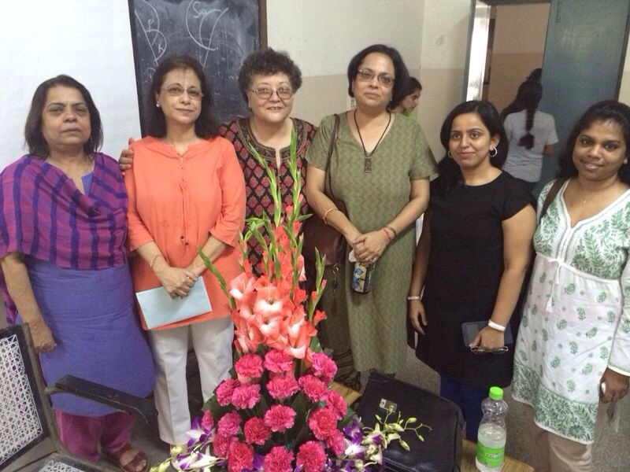
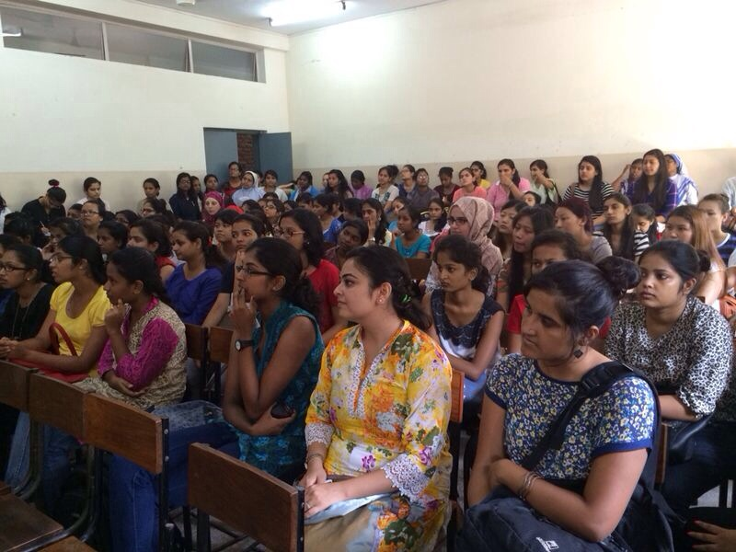
Book Discussion Tears of Jhelum by Anita Krishnan

Slide 14
Name and Batch of Alumna | Achievement
Anandita Bajpai (2003) | currently a PhD candidate at the Research Academy of Leipzig (since 2009)
Yashmita Singh (2009) | Currently working with Sapient as associate Hiring.
Sanya Khanna (2011) | Social Science Teacher Nirmal Bhartiya School
Garima (2008) | Delhi University Rank Holder, won Maria Philip Merit Scholarship, Geeta Chopra Memorial Scholarship and PTSA Scholarship
Pournamy (2012) | Interned with UN Women and Centre for Policy Research
Raashi Jain (2012) | Best Researcher Award Oxford University India Moot Court Competition
Himasweta Choudhury (2012) | Interned with Omeo Kumar Das Institute of Social Change and Development 2013
Ramya Boddupalli (2007) | Consultant at UNDP, deputed as a Fellow in the National Rural Livelihoods Mission (NRLM), Ministry of Rural Development, Delhi
Pooja Ravi (2003) | Research Associate, Public Affairs Foundation, Bangalore, pursuing PhD on Water Reforms, the Urban Poor and Citizenship, under Prof. Niraja Gopal Jayal in JNU
Oshanie Fernandes | Consultant, Amnesty International
Meera Gopakumar (2010) | Maria Philip Awardee

Slide 15
STUDENTS’ ACHIEVEMENTS
Name of student | Class | Posiion | Date
Pulkita Goel | Pol. Sc. Hons Passed | 9th NITAT Aptitude Test All India Level Amongst top 24% nation wide 10th NITAT Top 4% nation wide | February 2013 February 2014
Sanna Bedi | Pol. Sc. Hons. Passed | Managerial Position with AISSE Delhi Event President, Youth to Business Forum engaging 2000 students of Delhi University Awarded Best Member Most Promising Member European Union Parliament Awarded Euro 300 for ERASMUS Scholar Reward Conducted research for EU Parliament Handbook | 2011-2013 January 2013 July 2012 2013 (Brussels) 2014

Slide 16
Arushruli Bansal Prachi Sharma | Pol.Sc Hons Passed | Members of Manthan – a college of Business Studies initiative under which street plays create awareness in schools, markets and villages Be on the streets – UN Information supported and NGO | 2012, 2013 and 2014
Diksha Mathur | Pol.Sc.Hons Passed | Participated at India Lativa Fiesta (IFL) Largest Latin Fest in India and PTC Award Show Performed with Vivek Oberoi, Daljit , Mika etc.
Prachi Bhardwaj | Pol.Sc Hons Passed | AIESEC in Delhi IIT State Level Managerial Development Sector Project Head – Balakalakaar AIESEC National Level Award: AIESEC in Delhi IIT – Dev. Sector won national award Most progressive Award | 2012-2014 2013 June 13-Dec.13 2014

Slide 17
Mansi Wadhwa | Pol.Sc Hons. Passed | Certificate in Public Policy Centre for Civil Society, 2012 Team Member Winner of N.N. Aggarwal paper Presentation – 3rd Prize in 2014 Part of top 15 teams in India in Competition Manthan organized by citizens for Accountable Governance Internships Centre for Micro Finance Jaipur Institute of Development Studies Jaipur Co-authored paper with Dr. Joshi “Artisans behind the veil” Commonwealth Human Rights Initiative, New Delhi | Feb. 2013 Dec. 2011 May-July 2012 July 2013
Vishakha Mathur | III Hons, Pol.Sc. | Heading- Training and Recruitment Becoming I Foundation (NGO) Interned with The Hyderabad Times | November 2013 –present July 2014
Manvita Gandhi | III Hons, Pol.Sc. | Columnist University Express Sub- Editor University Express | March-December 2013 Jan-April 2014
Dorothy Zena Vellado | III Hons, Pol.Sc | Won several Dance Competitions across the Colleges of DU and IIT Delhi | 2012-14
Akanksha Khullar | III Hons, Pol.Sc | Interned with News X Went for an exchange program on Sustainable Development Project for six weeks to Mauritius | June 2014 Dec 2012-Feb 2013

Slide 18
POSITION HOLDERS
Name | Course (Academic Year) | Year | Merit
Saheli Ghosh | Pol Sc(Hons.) 2006-07 | 3 | 7th sharing in South Delhi Campus (SDC)
Hamisha Puri | Pol Sc(Hons.) 2006-07 | 3 | 2nd in College
Ms Shinjini Basu | Pol Sc(Hons.) 2007-08 | 3 | 1stin JMC
Ms Meera Gopakumar | Pol Sc(Hons.) 2007-08 | 1 | 3rd in SDC
Ms Divya Anand | Pol Sc(Hons.) 2007-08 | 1 | 4th sharing in SDC
Ms Melissa Marjulu Cyrill | Pol Sc(Hons.) 2007-08 | 1 | 4th sharing in SDC
Ms Yamini Pandey | Pol Sc(Hons.) 2007-08 | 1 | 5th position in SDC
Ms Meera Gopakumar | Pol Sc(Hons.) 2008-09 | 2 | 1st in SDC
Ms Radhika Kapoor | Pol Sc(Hons.) 2008-09 | 3 | 1ST in College
Ms Swati Bhanot | Pol Sc(Hons.) 2008-09 | 2 | 8th sharing in SDC
Ms Melissa Cyrill | Pol Sc(Hons.) 2008-09 | 2 | 10TH in SDC
Ms Ashni Gupta | Pol Sc(Hons.) 2008-09 | 1 | 6th sharing in SDC
Ms Garima Deepak | Pol Sc(Hons.) 2008-09 | 1 | 8TH in SDC
Ms Sanya Khanna | Pol Sc(Hons.) 2008-09 | 1 | 9th sharing in SDC
Ms Yaoreiphy Awungshi | Pol Sc(Hons.) 2008-09 | 1 | 9th sharing in SDC

Slide 19
Ms Meera Gopakumar | Pol Sc(Hons.)2009-10 | 3 | 2nd in SDC
Ms Shazadi Batra | Pol Sc(Hons.)2009-10 | 3 | 5th sharing in SDC
Ms Divya Anand | Pol Sc(Hons.)2009-10 | 3 | 8th sharing in SDC
Ms Melissa Cyrill | Pol Sc(Hons.)2009-10 | 3 | 8th sharing in SDC
Ms Sanya Khanna | Pol Sc(Hons.)2009-10 | 2 | 5th in SDC
Ms Garima Deepak | Pol Sc(Hons.)2009-10 | 2 | 7th sharing in SDC
Ms Pooja Kalita | Pol Sc(Hons.)2009-10 | 1 | 7th sharing in SDC
Ms Yashmita Sen | Pol Sc(Hons.)2009-10 | 1 | 9th sharing in SDC
Ms Garima Deepak | Pol Sc(Hons.)2010-11 | 3 | 8th in SDC
Ms Sanya Khanna | Pol Sc(Hons.)2010-11 | 3 | 10th in SDC
Ms Jyoti | Pol Sc(Hons.)2010-11 | 2 | 4th in SDC
Ms Hema Shweta Chowdhary | Pol Sc(Hons.)2010-11 | 2 | 6th in SDC
Ms Pooja Kalita | Pol Sc(Hons.)2010-11 | 2 | 8th in SDC
Ms Shivani Dewan | Pol Sc(Hons.)2010-11 | 1 | 3rd in SDC
Latika Tuteja (2004) from the Department was Delhi University Gold Medalist

Slide 20
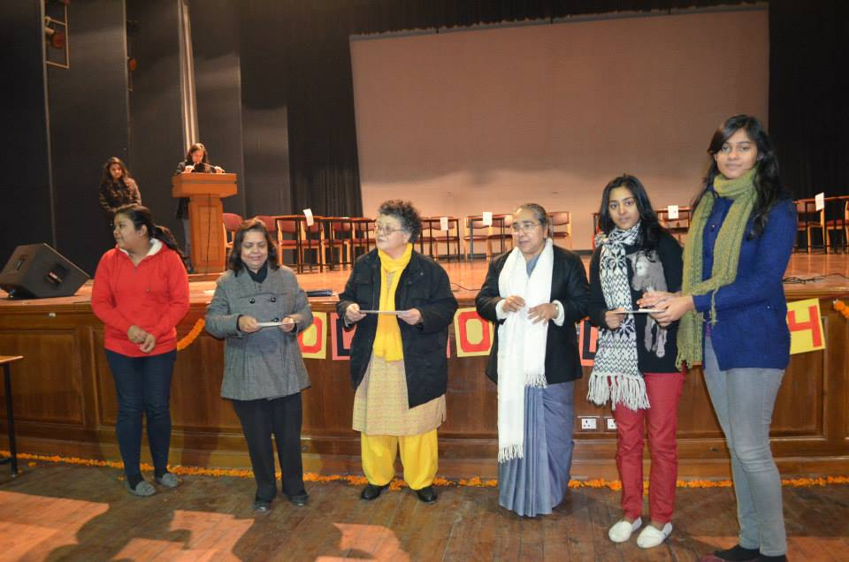
Student Projects
Percentage of students who have done in house projects including Inter Department Programmes:
Projects: 100%
Inter departmental: Approx. 50%
Percentage of students placed for projects in organizational outside the institution i.e. Research jobs/Industry/Others
2–3%

Slide 21
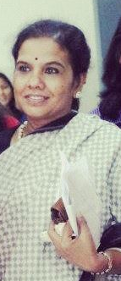
Outstanding Achievements/Awards/Recognition Received by Faculty Members
Dr. Sushila Ramaswamy
UGC Research Award for 2004-07 for a project on Post Cold War Social Concerns: Women’s Representation in a Comparative Perspective
Fulbright Post Doctoral Fellowship for Dissent and Confirmation: The Neo conservative Reaction to the American Political Process, Department of Political Science, Indiana University, Bloomington, Indiana, USA, August 1991- February 1992.

Slide 22
Membership of National/International Committee or Editorial Board
Dr. Sushila Ramaswamy
Visiting Fellow, Department of Political Science, National University of Singapore, 1996
Curriculum design for MA in Gandhian Studies Programme for IGNOU, New Delhi, 2010-12.
Subject Expert (Political Theory) Board of Studies, B.P.S.M. Girls’ College, Khanpur-Kalan, Sonepat, Haryana, 2009.
Compiled bibliography for Political Theory/Thought sections for UGC Committee on Development of Curriculum for Political Science and Public Administration, 2000.

Slide 23
Eminent Persons Visiting the Department
Prof. Brahma Chellaney, Geostrategist (Centre for Policy Research)
Prof. Mushirul Hasan, Historian
Prof. M.P. Singh, Professor and Former Head, Dept. of Pol. Sc. (University of Delhi)
Prof. Imitiaz Ahmed, Professor of Sociology (Jawaharlal Nehru University)
Prof. Gopal Guru, Professor of Political Science (Jawaharlal Nehru University)
Dr. Bulbul Dhar, Associate Professor, (Jamia Milia Islamia)
Prof. Valerian Rodrigues, Professor of Political Science (Jawaharlal Nehru University)
Mr. H. Karlekar, distinguished Indian Journalist, Consultant Editor, The Pioneer

Slide 24
Infrastructural facilities
Library
Approx. 3500 books and a Journal of Political Economy
Internet Facilities for Staff and Students
The college is wi-fi enabled and students and staff have free access to the internet.
Class rooms with ICT Facility
Class rooms are equipped with projectors to enable students to make power-point presentations.

Slide 25
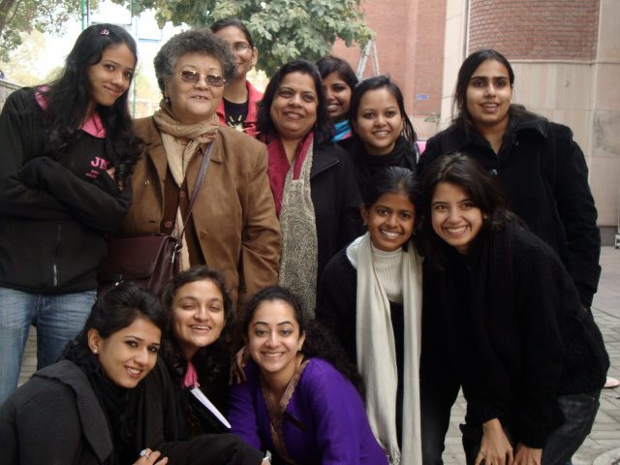
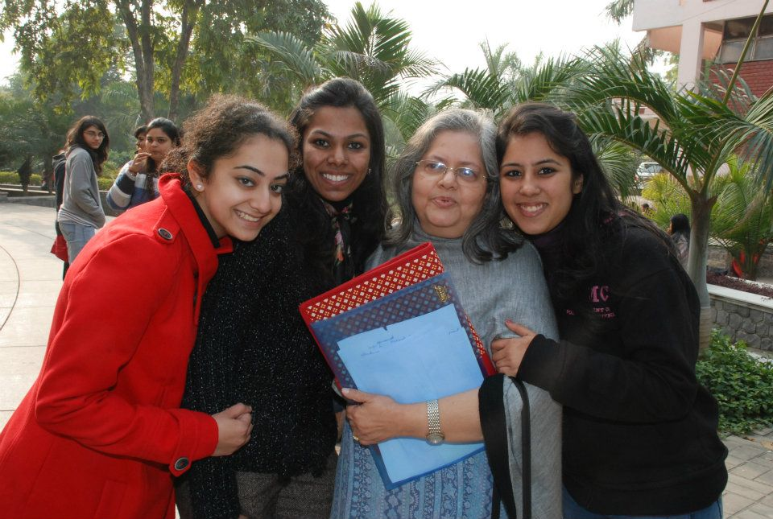
Innovative Teaching Methods
Communicative Classrooms and Discussions
Tutor Ward System with Mentors for Student Groups
Movies Screening
Field Work (Also visits to the Parliament and Panchayats)
Power Point Presentations
Paper Presentations

Slide 26
STRENGTHS OF THE DEPARTMENT
Highly Qualified Faculty - More than 70% of the Faculty members are Ph.D.
Highly Experienced Faculty - Majority of Faculty members have thirty to forty years of teaching experience. . They have also supervised Ph.D. thesis.
Promising Student Performance - Ex-students as well as current students of the department are working in various important fields.
Good Academic Record – Many of our students hold University positions
Informed, socially engaging pedagogy – Our students undertake field trip and visits to Panchayats and Parliament. They are also encouraged to carry out discussions and debates on important socio-political issues and challenges facing the country.
Usage of technical and innovative teaching and evaluation methods: Project reports, PowerPoint based presentations, online reading material, internet resources.
Active Faculty involvement in student related programs: In capacity of convenors of societies like Student Council, NSS, WSDC, ECA, Anti-ragging, Committee against sexual harrassment etc.
Dr. Sushila Ramaswamy, one of our faculty members, is a well known name in the discipline, has received various prestigious awards and has a number of quality publications to her credit.
One of our Faculty members has received intensive counselling training by Sanjeevani and has served on the College Counselling Cell.

Slide 27
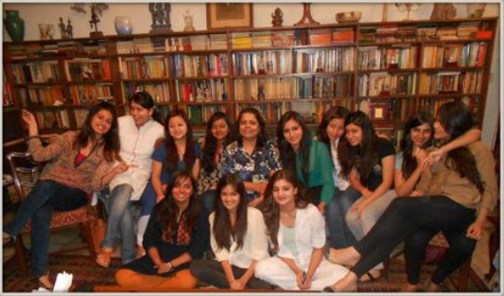
SWOC Analysis of the Department
Strengths –
More than 70% of the faculty members are PhDs
Good Student Teacher Relationship
Student Feedback and Teacher Evaluation
Fairly comprehensive syllabus
Innovative Teaching Skills
Weaknesses
No comparison of results since 2012 as the University has not been providing the gazzette
Opportunities, Challenges and Future Plans
To prepare students to comprehend latest technology and methods
To equip students with theoretical rigor as well as technical skills and enable them to become globally competitive.
Preparations are on for convening an International Seminar
The department Intends to start an ongoing research project for students

Slide 28
Thank you

